Slide 1
HOTEL BOOKING Data Analysis
Performance Evaluation of City & Resort Hotels (2015–2017)
Tools Used: Power BI | Power Query | DAX
Project Type - EDA
PRESENTED BY -
Ranjana Pise

Slide 2
Project Summary :
This project evaluates the business performance of City Hotel and Resort Hotel from 2015 to 2017.
It contains information about bookings, revenue, stay duration, cancellations, number of guests (including children), waiting period, repeated guests, food preferences, booking countries, and booking channels like agents.
Identify factors affecting revenue and cancellations.
Evaluated operational efficiency, customer satisfaction, and market positioning.
Compare City Hotel vs Resort Hotel
Built interactive Power BI dashboards for yearly and weekly analysis.
Generated insights to improve profitability, reduce cancellations, and support sustainable growth.

Slide 3
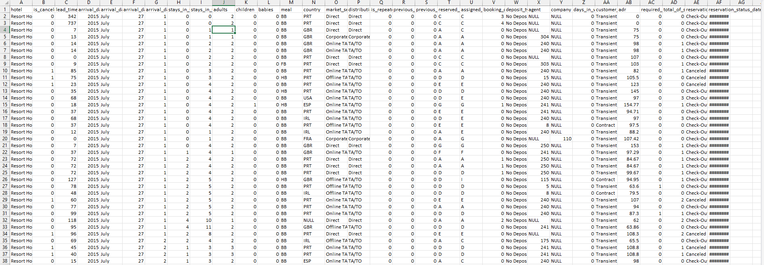
Dataset First View :

Slide 4
Columns names :
Hotel, is_canceled lead_time, arrival_date_year, arrival_date_month, arrival_date_week_number, arrival_date_day_of_month, stays_in_weekend_nights, stays_in_week_nights, adults, children, babies ,meal, country, market_segment, distribution_channel, is_repeated_guest, previous_cancellations, previous_bookings_not_canceled, reserved_room_type, assigned_room_type, booking_changes, deposit_type, agent, company, days_in_waiting_list, customer_type, adr, required_car_parking_spaces, total_of_special_requests, reservation_status, reservation_status_date

Slide 5
Dataset Overview :
The given dataset is of Hotel Booking and we have to analyze and explore this dataset to discover important factors which affects the Hotel Booking.
Total Records: 119,390 rows
Total Columns: 32 columns
Data includes:
Booking details
Customer information
Revenue & ADR
Cancellation data
Guest count
Booking channels

Slide 6
Data Cleaning & Preparation :
Removed 31,994 duplicate records .
Identified missing values in are 4 columns :
Company – 82133 (93%)
Agent - 12191 (13%)
Country – 452 (< 1%)
Children
Handled null values using appropriate methods
Converted date columns into proper format
Removed inconsistencies

Slide 7
Feature Engineering :
New Columns Created :
Total Stay = Week Nights + Weekend Nights
Total Revenue = ADR × Total Stay
Total Guest = Adults + Children + Babies
Satisfaction Level -> [Reserved_room_type] = [Assigned_room_type]
Agent Column = Null value replace with the Zero
Add Primary Key = Booking ID
Deleted Columns :
Comapany Column (93 % records are null values) , Repeated_Guest Column (96 % records zero values), Previous_Cancellations Column(98% records zero values ) , Previous_booking_not_Cancelled Column(95% records zero values ) , day_in_waiting_list(95% records zero values).
These transformations improved analysis accuracy.

Slide 8
Key KPIs Created :
Total Revenue - ₹3,44,60,331.81
Total Bookings - 87392
Average ADR - 106.34
Average Total Stay - 3.63 nights
Count of Country – 178
These KPIs give a quick overview of overall hotel performance.

Slide 9
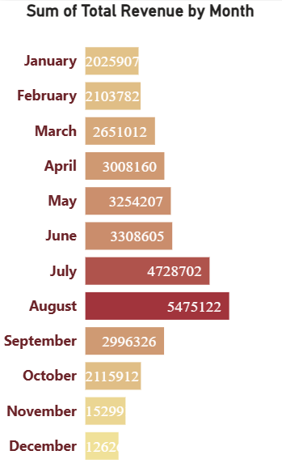
Revenue by Month :
Revenue shows a gradual increase from January to June.
July and August record the highest revenue, indicating peak season.
Revenue declines after August, showing a seasonal pattern.
💡 Insight
Peak months are July–August, ideal for dynamic pricing and capacity planning.

Slide 10
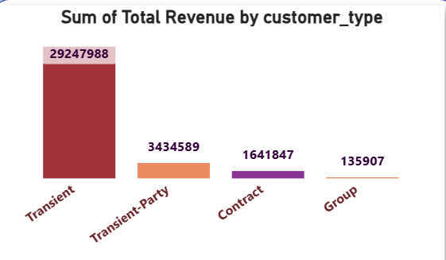
Revenue by Customer Type :
Customer Contribution to Revenue :
Transient customers generate the highest total revenue.
Transient-Party and Contract customers contribute moderately.
Group customers contribute the least.
💡 Insight
Business should focus more on Transient customers for revenue growth.

Slide 11
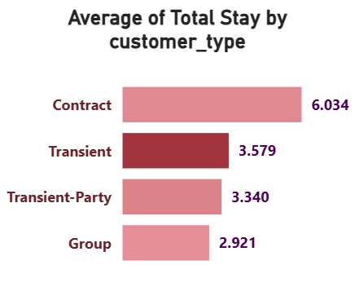
Average Stay by Customer Type :
The dataset contains four different customer types: Contract, Transient, Transient-Party, and Group.
Stay Duration Analysis :
Contract customers have the longest average stay.
Transient customers show moderate stay duration.
Group bookings have shorter stays.
💡 Insight
Long-stay customers help maintain stable occupancy.

Slide 12
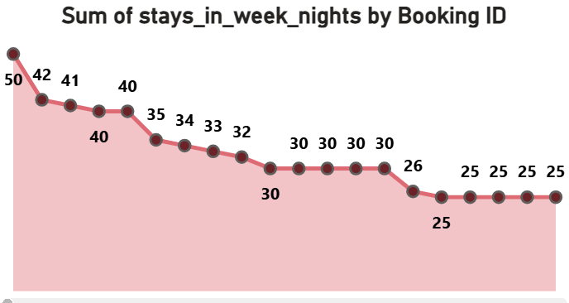
Week-Night Stay Pattern :
Stays in Week Nights :
Higher number of bookings include week-night stays.
Gradual decline shows shorter stays in later bookings.
💡 Insight
Hotels are more occupied during weekdays, useful for pricing strategy.

Slide 13
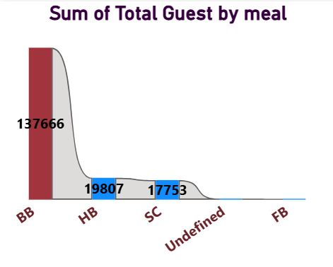
Guest Meal Preference Analysis :
🍴 Meal Type Preference
BB (Bed & Breakfast) is the most preferred meal plan.
HB and SC have lower demand.
FB has very limited preference.
💡 Insight
BB meal plans should be prioritized to match customer demand.

Slide 14
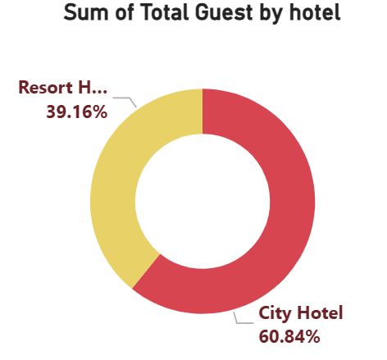
Hotel-Wise Performance Analysis :
🏢 City Hotel vs Resort Hotel
City Hotel shows higher booking volume.
Resort Hotel benefits from premium stays and amenities.
Filters allow comparison for better business decisions.
📅 Seasonal Booking Behavior
Peak bookings during summer vacation months.
Lower demand during end-of-year months.
💡 Insights
City Hotel drives volume, Resort Hotel supports premium revenue.
Seasonal staffing and promotional strategies are required.

Slide 15
Suggestion & Solutions :
Key Observations :
Hotel bookings increase significantly from April to August. This period represents the peak travel season.
Higher guest volume directly impacts service quality and operations.
Business Recommendations :
Increase staff strength during April–August to manage high demand and maintain service quality.
Plan inventory and resources (food supplies, housekeeping, amenities) in advance to avoid shortages.
Optimize operations during peak months to improve guest satisfaction and maximize revenue.
For Resort Hotels, focus on enhancing amenities and facilities to attract premium customers and increase Average Daily Rate (ADR).
Providing a complete and enjoyable guest experience helps improve repeat bookings and brand value.

Slide 16
Result / Conclusion :
City Hotels recorded higher bookings and revenue, with peak performance in 2016.
July and August consistently show the highest booking volume due to vacation season
Most guests do not require car parking, suggesting limited need for additional parking investment.
Agent bookings dominate, indicating strong dependence on third-party channels.
Major booking countries include Portugal, United Kingdom, France, and Spain.
Room types A and D are the most preferred.
Guests often show repeat booking behavior, reflecting customer loyalty.
BB (Bed & Breakfast) is the most popular food choice.

Slide 17
Final Conclusion :
This dashboard provides a complete Annual and Weekly view of hotel booking performance.
It helps management understand revenue trends, customer behavior, and seasonal demand, enabling data-driven decisions to improve profitability and operational efficiency.

Slide 18


Slide 19
* Thank you *

